Slide 1


A rad Application Platform
Introducing
@PalmEmanuel
Notes:
Intro – story about containers, modernization
Raise of hands – Who’s a developer? Who would like to spend less time needing to learn and write templates for Kubernetes, ARM or other IaC, or at least simplify it?

Slide 2
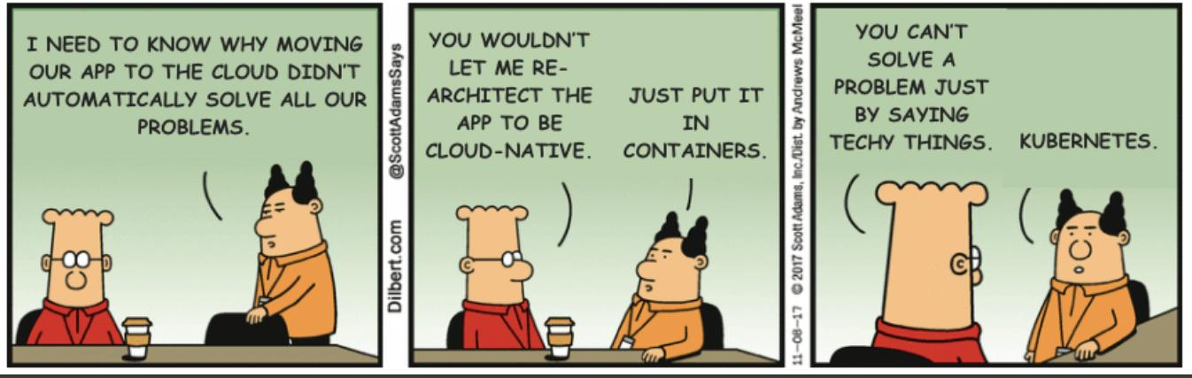
Notes:
Raise of hands
Is this your application?
No. Kubernetes is not your application.
Is this your application?
Maybe. It has components, identities and integrations outside wherever it resides.

Slide 3




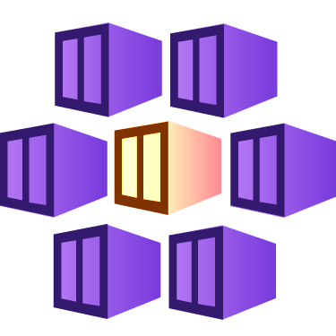


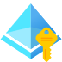





Your App
Key Vault
Kubernetes
Storage
Function
Managed Identity
Notes:
Raise of hands
Is this your application?
No. Kubernetes is not your application.
Is this your application?
Maybe. It has components, identities and integrations outside wherever it resides.

Slide 4
Appi-ness
the feeling of satisfaction one has when the application is at the center of every workflow

Slide 5

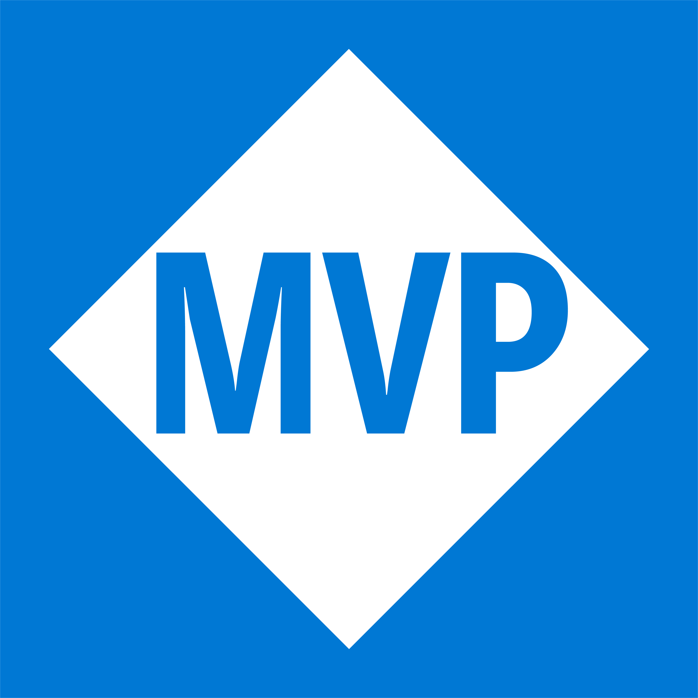
Emanuel Palm
@PalmEmanuel
🧙☕🍰🧗🥏
❤️ Everything-as-Code
📦 Makes modules & tools
📃 Fan of Open Source
☁️ Blogs at pipe.how

Slide 6


Session Overview
1
2
3
Radius?
Demo
Summary & Questions

Slide 7
≠
Remote Authentication Dial-In User Service (RADIUS)

Slide 8

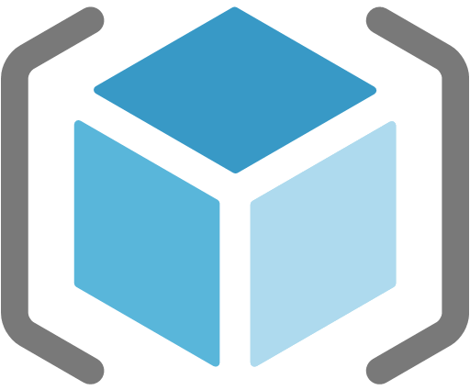
Azure Resource Manager (ARM)
Bicep
Radius

Slide 9
Notes:
Pretty humerus, you could say

Slide 10



Slide 11
Radius was created to bridge the gap
between developers and operators & platform engineers
To create a common understanding and visualization of what an application is
The same way that system-assigned managed identities in Azure tie the lifecycles of the identity and the resource together, Recipes in Radius can help achieve that for your entire application

Slide 12
Notes
There is a codespace to get started, or a bunch of alternatives for installation
News since release (0.28 or 0.29 for example)
Upcoming presentation info at https://docs.radapp.io/community/overview/
There’s a roadmap
Currently only runs in Kubernetes, but looks at supporting serverless platform in the future
Currently you can only manage the cluster Radius is installed in, but multi-cluster support is planned
Talk about the concept of “appiness”, the feeling of satisfaction when the application is at the center of every workflow

Slide 13
UPC and Component Topography slide with diagrams

Slide 14
Bicep for Everything
Even AWS through the AWS Cloud Control API
Custom fork at the moment
Terraform works too

Slide 15
Where does Radius fit into your organization?
Last section of "Concept: Why Radius": "Developers and platform engineers need to collaborate". Explaining how the different parts of Radius fits into an organization with roles like platform engineers, operators, cloud and security experts, developers.
If your developers want cake, but your organization has an allergy against public access, you can create a recipe to ensure private networking.
In platform engineering, Microsoft talks about paving paths for your organization to make it easier to follow requirements and policies, Recipes can be a way to achieve that
If you have a bunch of apps today

Slide 16
Questions
How does Radius compare to X?
https://docs.radapp.io/concepts/faq/#comparison-to-other-tools

Slide 17
rad init
Notes:
Show codespace from VS Code
The anatomy of a template and Recipe
There’s a special VS Code extension (while they fork Bicep)
Deploying to both local environment and Azure

Slide 18
Summary
Radify your apps now
It’s well-documented and open source, and there are monthly community calls.
2
example
3
example

Slide 19
Very interesting facts!
This is where you section ends. Duplicate this set of slides as many times you need to go over all your sections.

Slide 20
Thank you!
Do you have any questions?
hello@mail.com
555-111-222
mydomain.com

